Slide 1

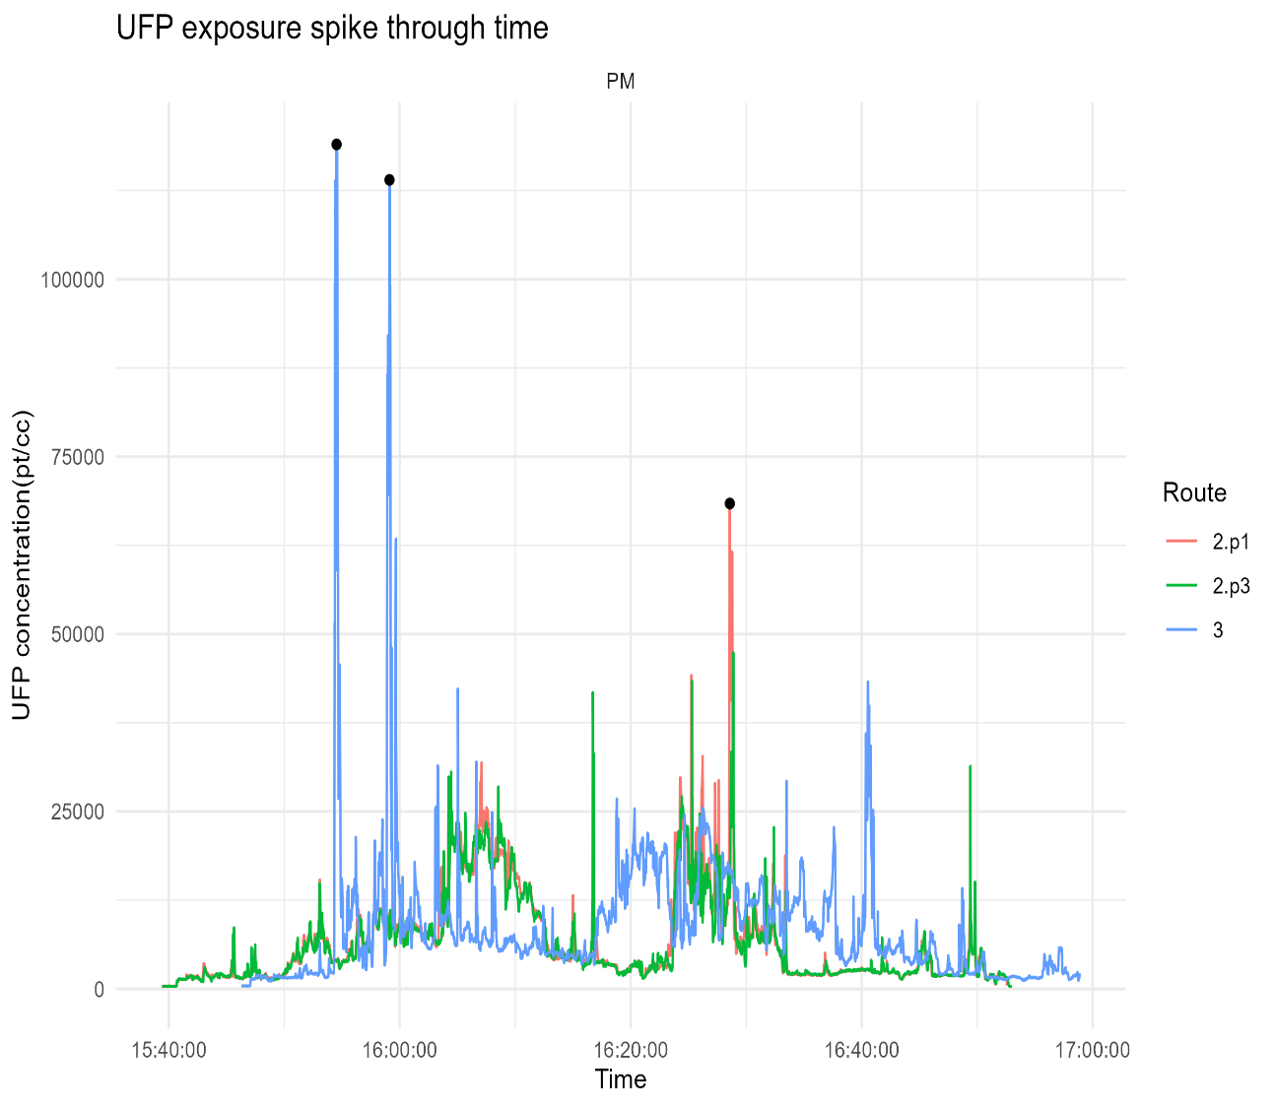
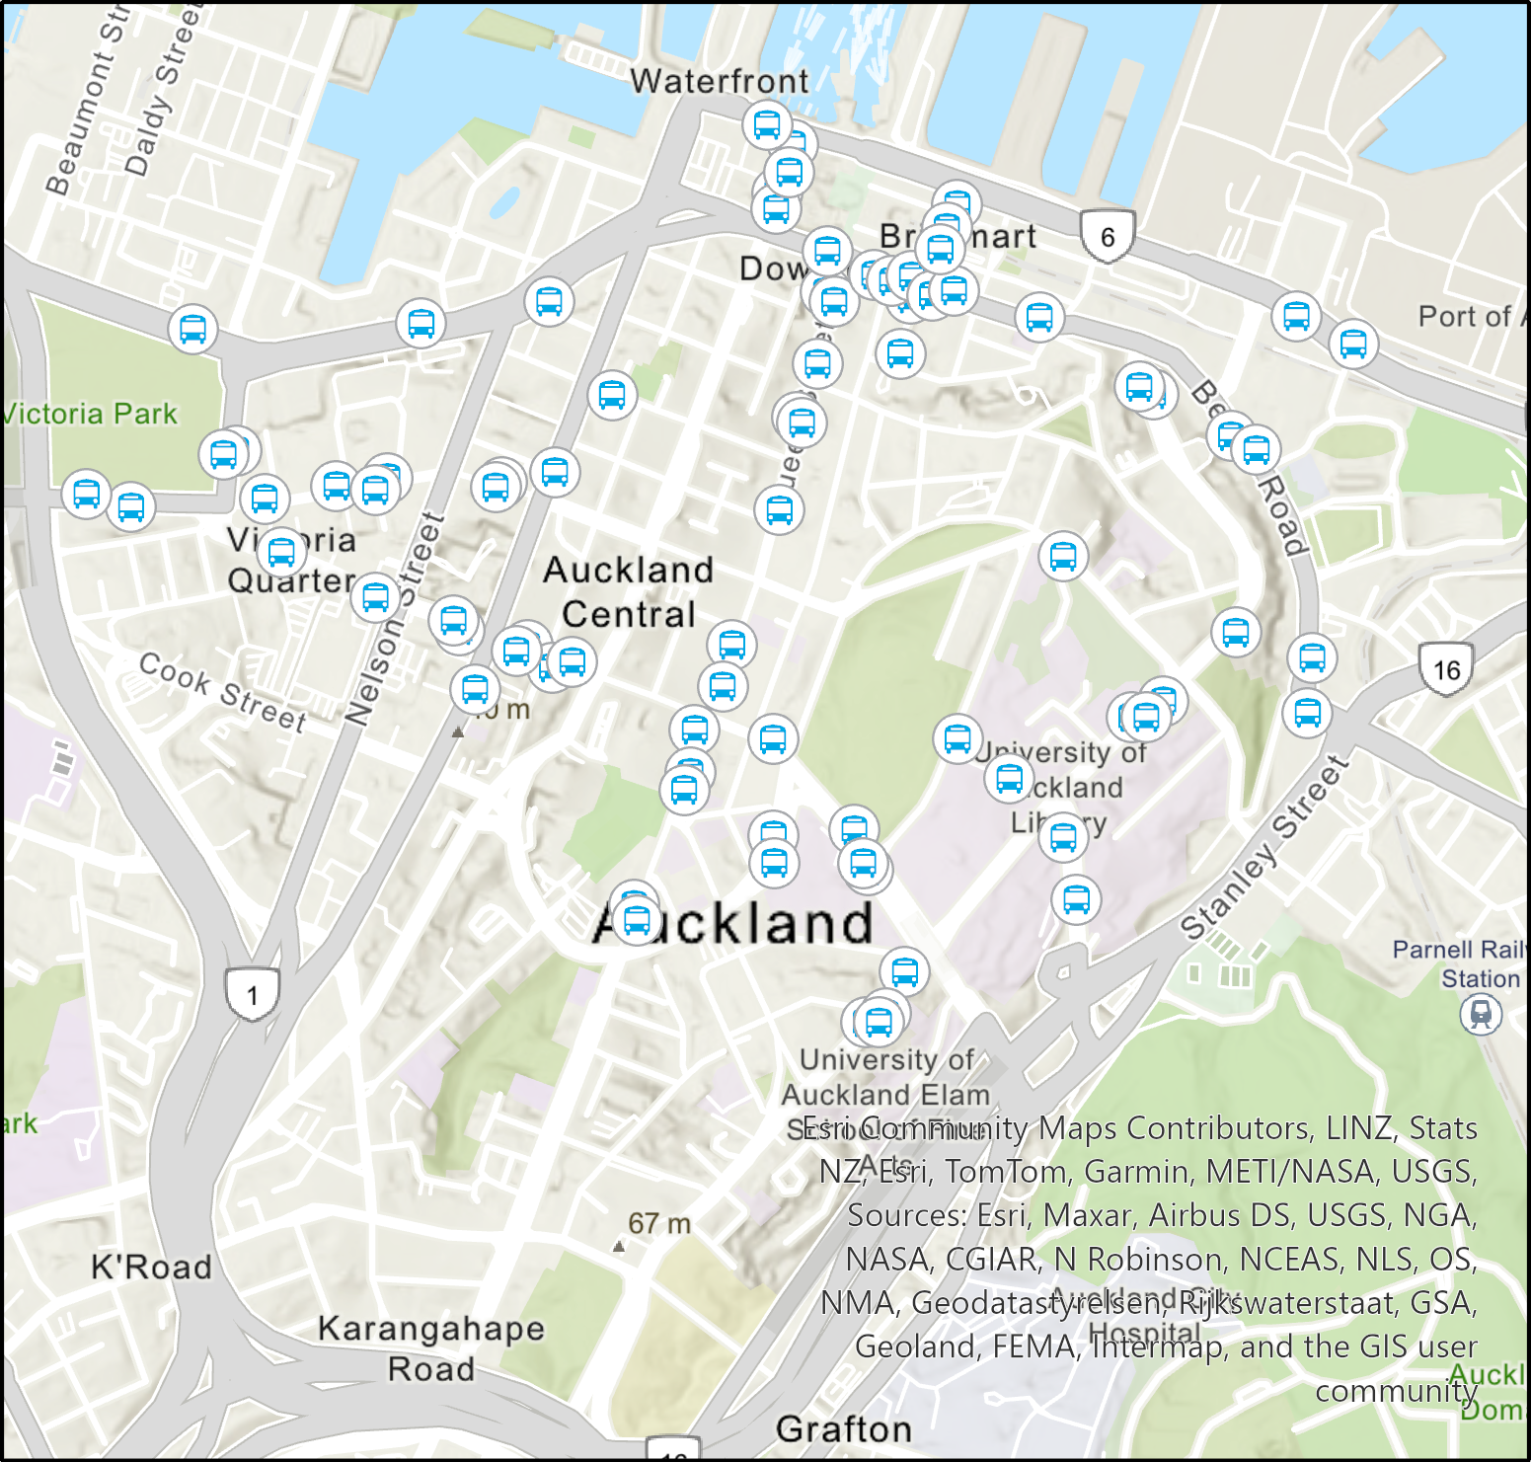
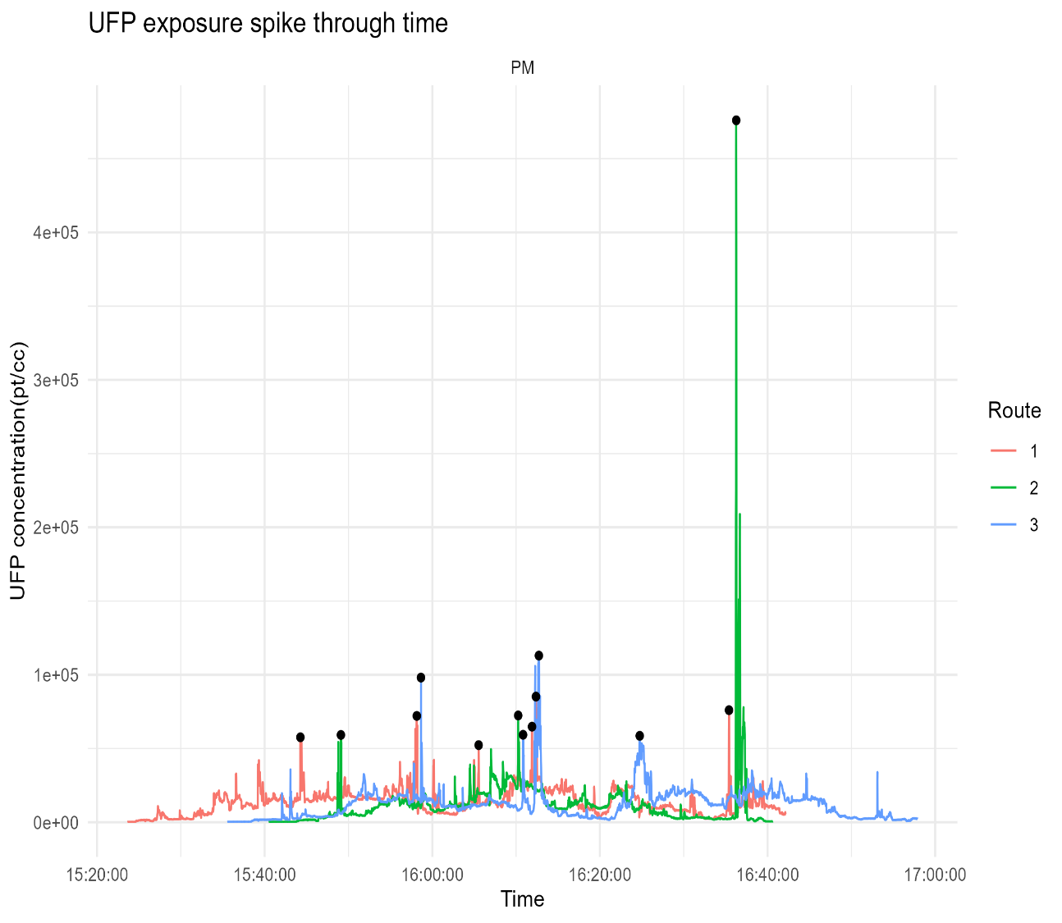
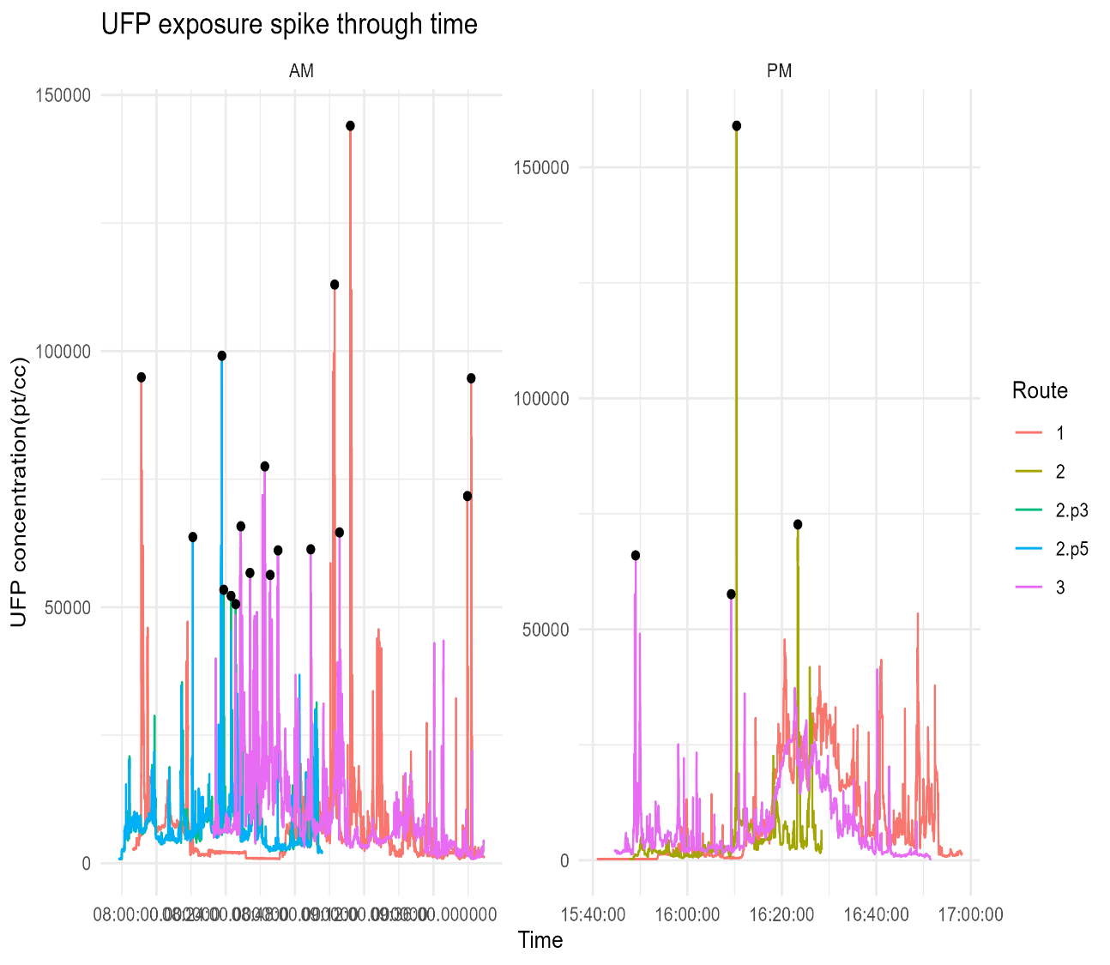
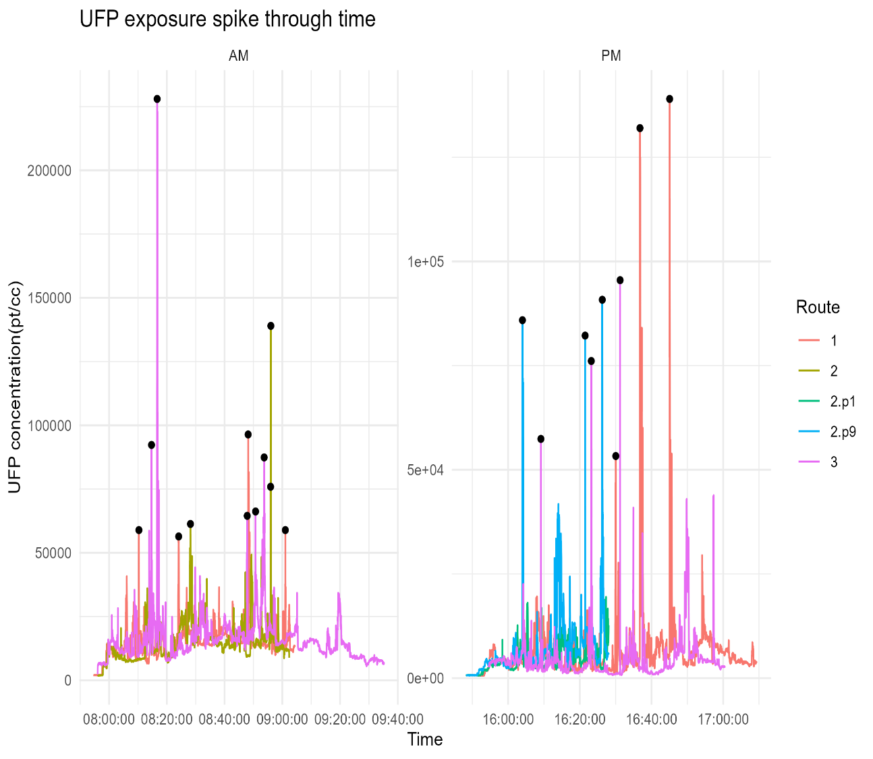

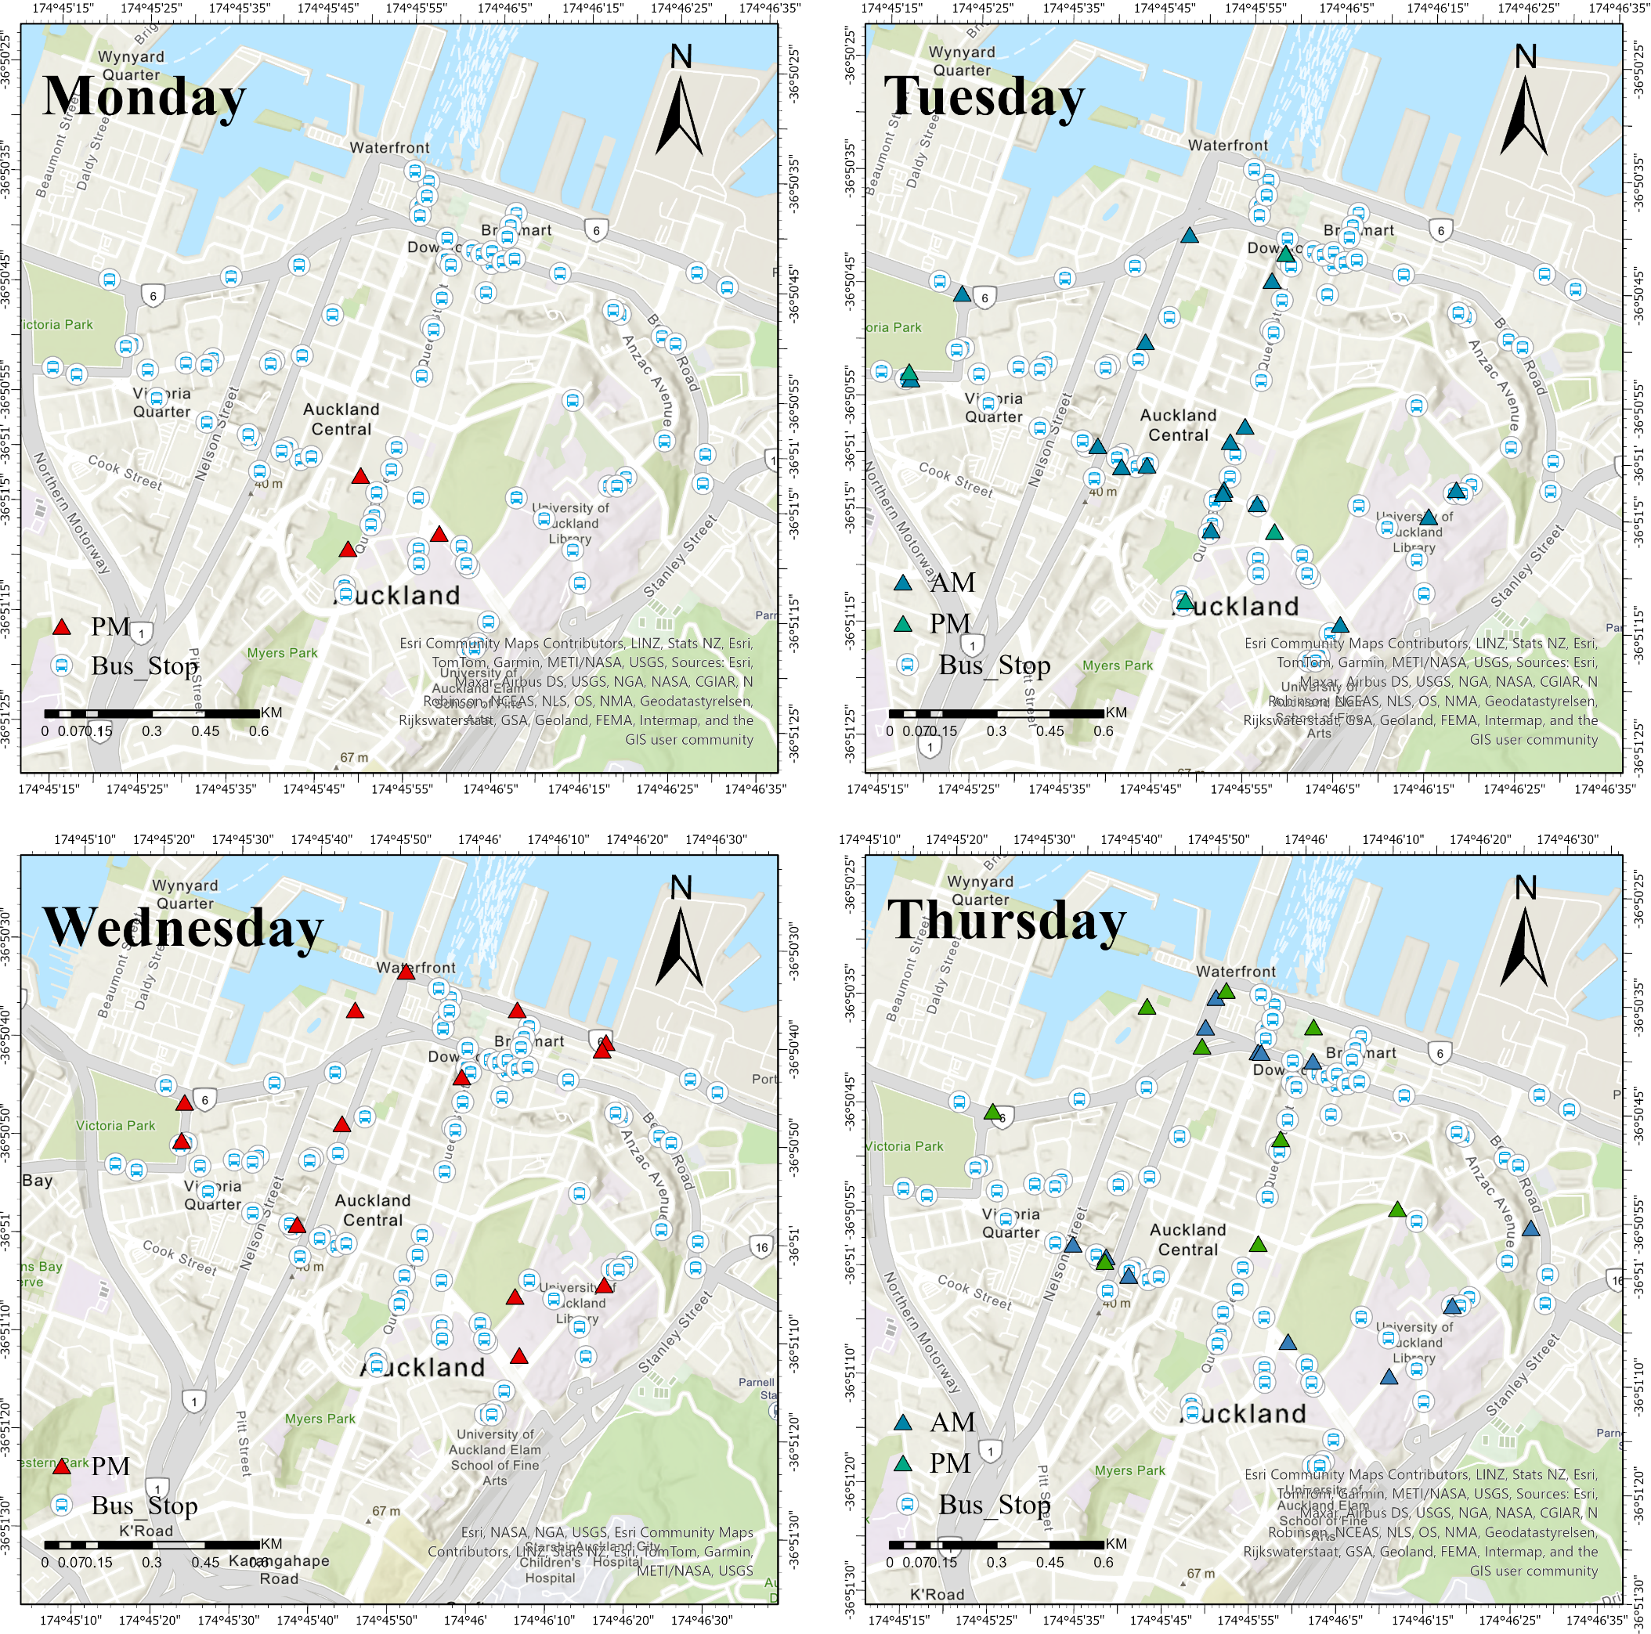
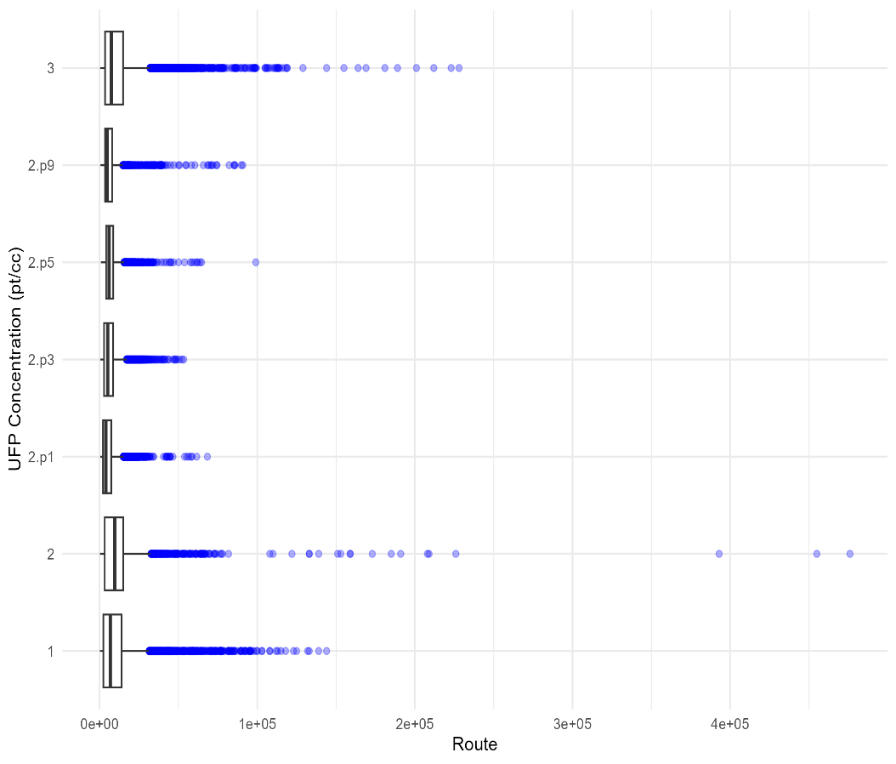

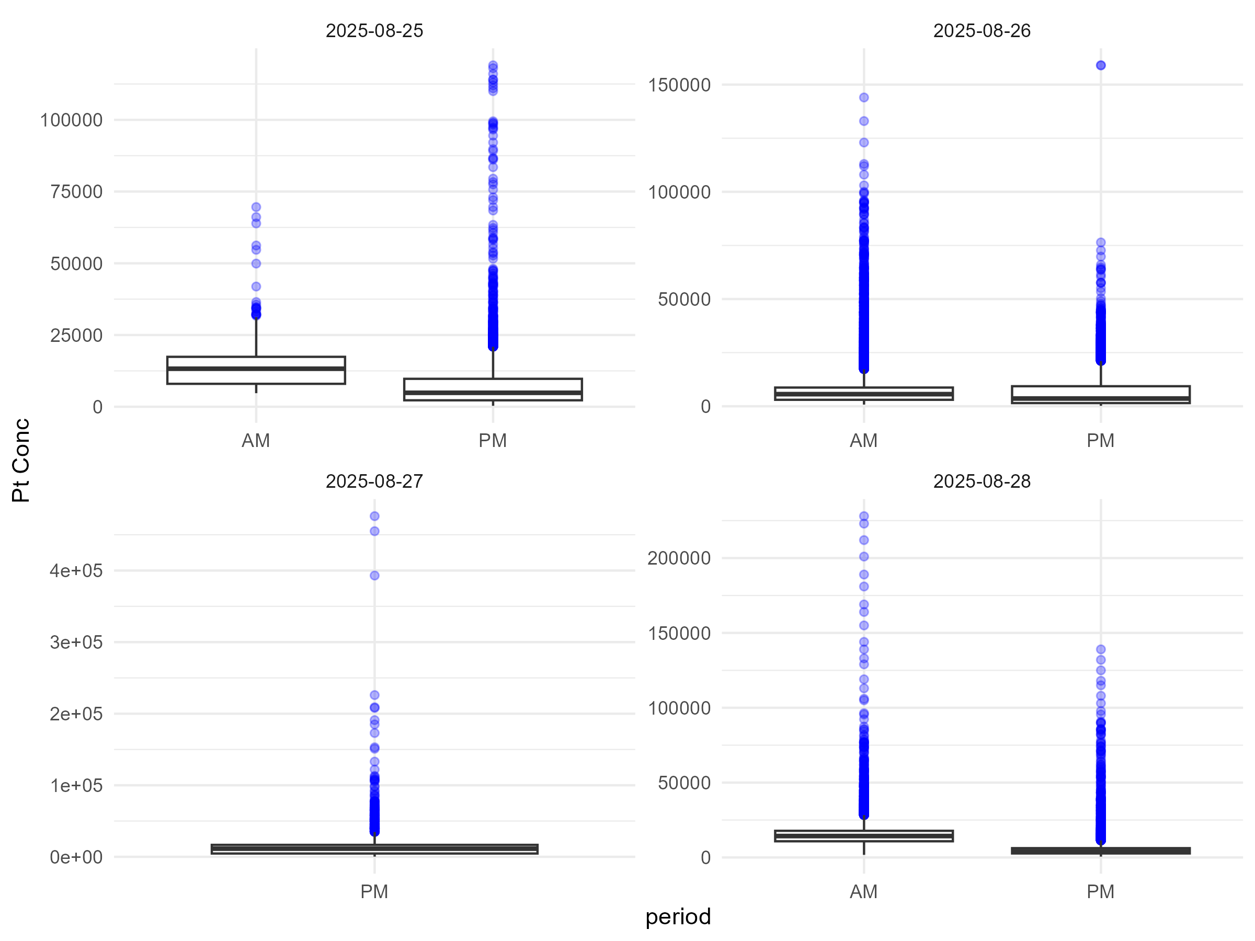
UFP exposure during commuting in Auckland: evaluating route and personal mitigation
Chang liu¹, Xinquan Jin¹ The environmental science, university of Auckland, New Zealand
Abstract
The study monitored UFP along three commuting routes in Auckland’s CBD using a P-Trak and GPS during weekday periods 07:45–09:30 and 15:45–17:30, extracting and mapping peaks ≥50,000 pt/cc. Results show that overall exposure (Q1/Q2/Q3) is higher in the morning peak than in the evening peak, and peaks cluster mainly along corridors with dense bus stops and intersections. Morning peaks are more dispersed, whereas evening peaks are more concentrated. Practically, traveling during the evening peak and keeping distance from near-source locations can reduce overall exposure.
Introduction
Methods
Ultrafine particles (UFP) are extremely small, highly reactive, and capable of depositing in the alveoli and entering the bloodstream, where they are linked to adverse respiratory and cardiovascular outcomes (HEI Review Panel on Ultrafine Particles, 2013; Ohlwein et al., 2019). In urban environments, traffic emissions are a dominant source of UFP (Kumar et al., 2014). Commuter exposure is shaped by both spatial factors (e.g., number of bus stops) and temporal factors (e.g., traffic intensity, meteorological conditions between morning and evening peaks) (Velasco & Tan, 2016).
To address this gap, we monitored UFP concentrations along three commuting routes with a shared origin point, using a P-Trak and GPS. Sampling was conducted during weekday morning (07:45–09:30) and evening (15:45–17:30) peaks from Monday to Thursday.
Fig.1 The UFP concentration Spike
Fig.2 The Bus station
Q1: Do differences in bus stop density across routes correspond to variations in personal UFP exposure?
Q2: Do weekday morning and evening peaks exhibit consistent differences in UFP exposure?
Results
Fig.3 Spatial distribution of bus stops and UFP spike events
Fig.4 Comparison of UFP Concentrations Between Different Routes
Data preprocessing
Raw UFP monitoring data were cleaned and standardized for temporal consistency.
Temporal analysis
Boxplots and line charts compared UFP concentrations across peak hours, routes, and daily patterns.
Peak extraction
UFP spikes (>50,000 pt/cc, 3-min resolution) were identified and extracted.
Spatial analysis
Spike events were mapped in ArcGIS Pro and overlaid with bus stops to highlight high-exposure zones.
Data from Monday and Wednesday are missing; figure shows afternoon UFP ≥ 50,000.
Peaks cluster near bus stops and intersections at Victoria Park.
Britomart shows no major peaks; multiple clusters observed along Customs St E.
Wellesley St × Hobson St is the most densely peaked location.
Additional peaks appear along Symonds St near the University of Auckland.
Morning peaks: wider, more dispersed distribution.
Evening peaks: concentrated near parking facilities and bus stops (e.g., Wilson Parking at the Waterfront and on Hobson St).
Discussion
Fig.4 Comparison of UFP concentrations between morning and evening peaks
Q1：UFP peaks are primarily clustered along corridors with dense bus stops and intersections, whereas Britomart—despite having many stops—shows no pronounced peaks. This indicates that “higher bus stop density → more peaks” holds to some extent but is not a sufficient condition; peaks are also jointly driven by factors such as bus dwelling/departures and vehicle merging at parking facility entrances/exits. Temporally, peak points are more dispersed during the morning rush but are more concentrated near bus stops and parking facilities in the evening, mainly because morning commuters originate from more dispersed locations, while evening pedestrian and traffic flows are more concentrated.
Q2：Lower morning mixing-layer height together with higher emissions from vehicle cold starts leads to AM being higher than PM (Choi et al., 2016; Jeong et al., 2004). Short-term high exposures are mostly caused by vehicle acceleration or street-canyon recirculation (Habilomatis & Chaloulakou, 2015; Tsang et al., 2008).
Practical implications: To reduce peak exposure, keep your distance from near-source locations or minimize the time spent near them; choosing to travel during the evening peak can lower overall exposure levels.
Morning peaks show overall higher exposure levels than evening peaks across Q1, Q2 (median), and Q3.
In both morning peak and afternoon peak, many points exceed the whiskers, indicating multiple short-term high-exposure events during commuting.
Conclusion
Reference
Based on mobile monitoring along three commuting routes in Auckland’s CBD, we find that overall exposure levels are higher in the morning peak than in the evening peak; UFP peaks cluster mainly along corridors with dense bus stops and intersections—indicating that higher bus stop density is associated with more peaks but is not a sufficient condition—and evening peaks are more spatially concentrated than morning peaks. Key limitations include:
incomplete data coverage;
the evening time window did not fully capture the entire evening rush period; and
roadside background sources (e.g., construction, delivery stops, heavy-vehicle corridors) were not accounted for, which may confound the relationship between bus stop density and peak occurrence.
Choi, W., Ranasinghe, D., Bunavage, K., DeShazo, J. R., Wu, L., Seguel, R., ... & Paulson, S. E. (2016). The effects of the built environment, traffic patterns, and micrometeorology on street level ultrafine particle concentrations at a block scale: Results from multiple urban sites. Science of the Total Environment, 553, 474-485.
Habilomatis, G., & Chaloulakou, A. (2015). A CFD modeling study in an urban street canyon for ultrafine particles and population exposure: The intake fraction approach. Science of the total environment, 530, 227-232.
Jeong, C. H., Hopke, P. K., Chalupa, D., & Utell, M. (2004). Characteristics of nucleation and growth events of ultrafine particles measured in Rochester, NY. Environmental science & technology, 38(7), 1933-1940.
Kumar, P., Morawska, L., Birmili, W., Paasonen, P., Hu, M., Kulmala, M., ... & Britter, R. (2014). Ultrafine particles in cities. Environment international, 66, 1-10.
Ohlwein, S., Kappeler, R., Kutlar Joss, M., Künzli, N., & Hoffmann, B. (2019). Health effects of ultrafine particles: a systematic literature review update of epidemiological evidence. International journal of public health, 64(4), 547-559.
Particles, H. (2013). Understanding the health effects of ambient ultrafine particles. HEI Perspectives, 32013.
Tsang, H., Kwok, R., & Miguel, A. H. (2008). Pedestrian exposure to ultrafine particles in Hong Kong under heavy traffic conditions. Aerosol and Air Quality Research, 8(1), 19-27.
Velasco, E., & Tan, S. H. (2016). Particles exposure while sitting at bus stops of hot and humid Singapore. Atmospheric Environment, 142, 251-263.

